Slide 1
Binary Search Algorithm

Slide 2
This Binary Search approach follows the strategy of "divide and conquer." It divides the list into two parts and compares the target item with the Element. If there's a match, congratulations! You've hit the jackpot. If not, the Search proceeds to the right side based on the comparison outcome.
Remember that Binary Search is effective on lists. If your list is unsorted, sorting it beforehand is essential before employing this method

Slide 3
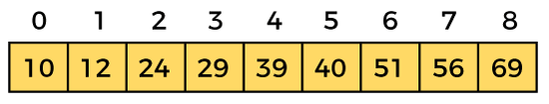
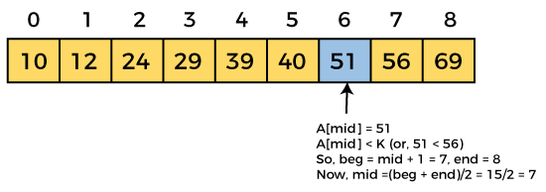
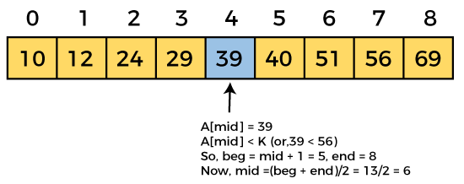
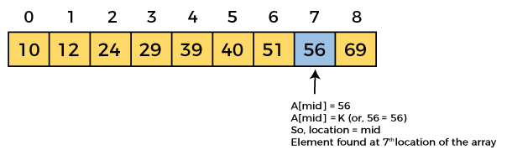
Working of Binary search
Let the element to search is, K = 56

Slide 4
Binary Search complexity
Case | Complexity
Best Case | O(1)
Average Case | O(logn)
Worst Case | O(logn)

